Slide 1

Edrington
Optimal Selection of Suppliers
Group 4
Samuel Bennie
Adel Shaman
Yash Sharma
Pin-you Lin
Yu Hong Wong
Lingyu Sun
Ruixian Zhao

Slide 2

Content
1
Introduction
2
Model
3
Recommendations
4
Conclusion

Slide 3

01
INTRODUCTION
What is the problem and what we are going to figure it

Slide 4
THE PROBLEM/ what is the objective
Optimal Combination of Suppliers
Minimise the COST
Maximise the QUALITY

Slide 5
PROBLEM SCOPE/ what are we going to do
Lead Time Filter
Time is one of the most important parameters in the industry.
We use this as the first constraints.
The user can input the maximum lead time.
Cullet Filter
This is a crucial parameter link with the quality of glass.
We use this as the second constraints.
User can input the range of the cullet needed.
Vendor Rating Competition System
If there are same cost presence, the one with high rank in the vendor will be chosen.

Slide 6

SOLVE PREBLEM/ We use Python
High Efficiency
Good at processing complex data
01
02
03
Good Scalability
Great Coordination
Easy to add new feathers in the further and can work with new data features
Can easy to apply this to the overall workflow without any other changes.

Slide 7
02
MODEL
How to use Python to build the model fit the scenario and solve the problem

Slide 8
THE DATASET/ and preprocessing the data
SKU
2
Lead Time
Min Cullet %
Max Cullet %
Suppliers
1
Delete all the strings and transfer those into floating varaibles
DATASET
3
Rating
Using 2 quarters mean overall ratings

Slide 9
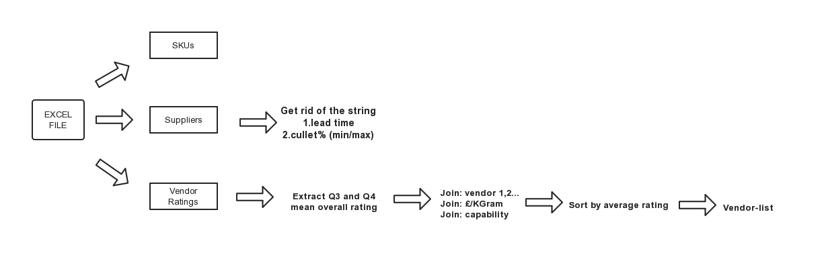
THE DATASET/ and preprocessing the data

Slide 10
THE DATASET/ and preprocessing the data

Slide 11
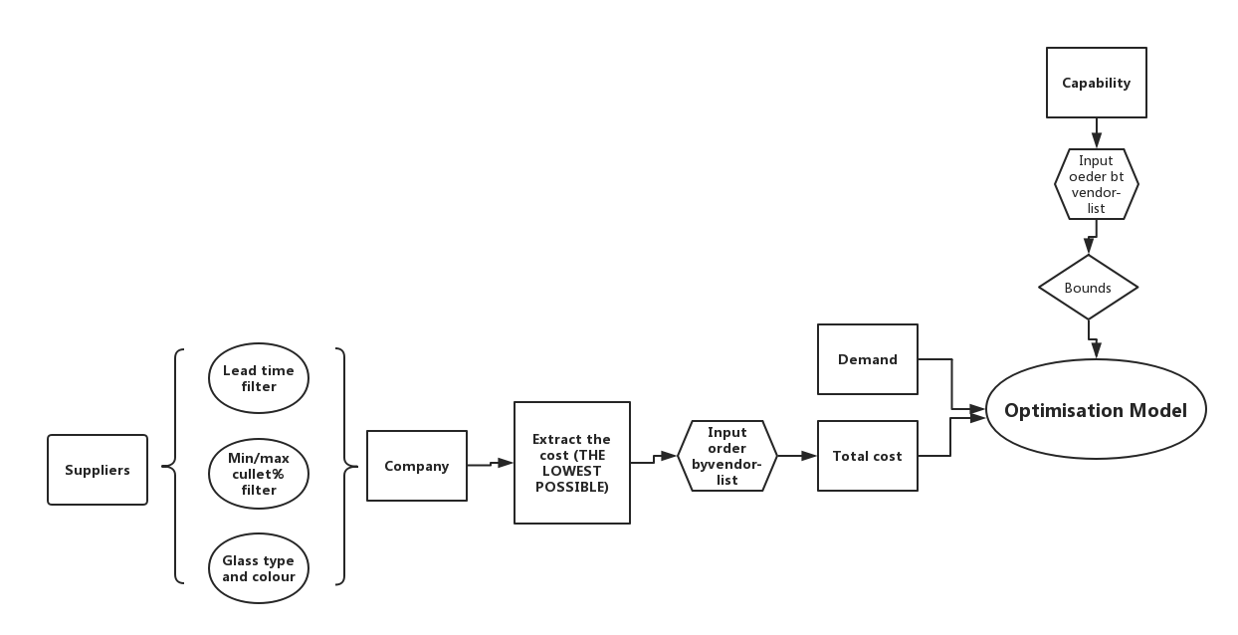
THE DATASET/ and preprocessing the data

Slide 12
03
RECOMMENDATION
Here is the example of the recommendations runs from the program

Slide 13
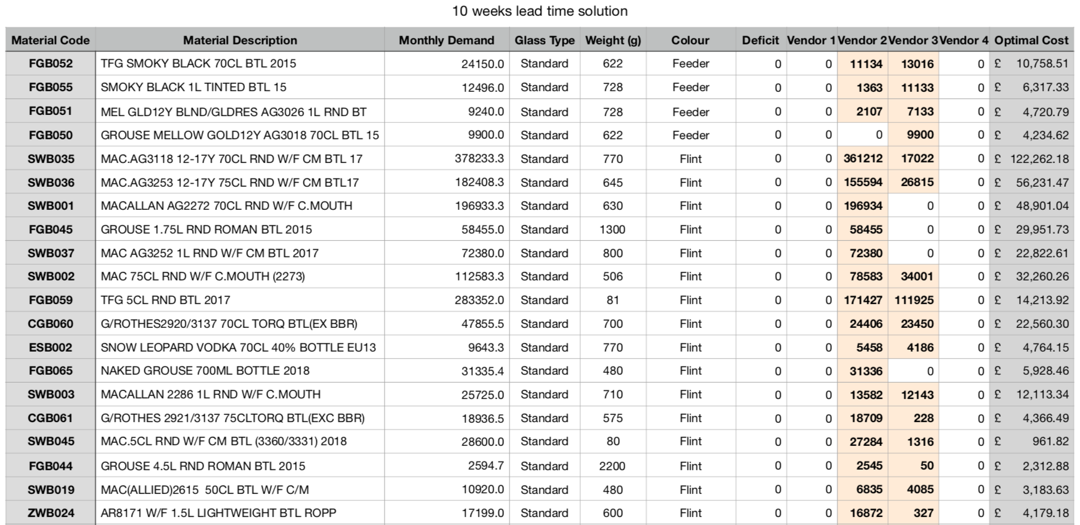
Recommendations/ solutions

Slide 14
04
CONCLUSION
Do you have any questions?

Slide 15
IMPROVE THE MODEL/ to fit more scenarios
Delayed submision
What if the supplier cannot provid the matrials in time, how to choose in the further.
Single product analyses
Run only a particular product
Other price factors
If the suppliers have sale policy
More complicated scenarios
Deliver factors, weather factors, if more feature of data appliable

Slide 16

Edrington
THANKS FOR YOUR ATTENTION
Group 4

